Slide 1

Exploring Power Optimisation System
Level Techniques for Wearables
Sajid Ali | 01341393
sajid.ali17@imperial.ac.uk
21st June 2021

Slide 2
Content at a Glance
Introduction and Motivation
Background Research
Component Selection
Power Optimisation Techniques
Prototype and Application Fabrication
Conclusion and Final Results

Slide 3
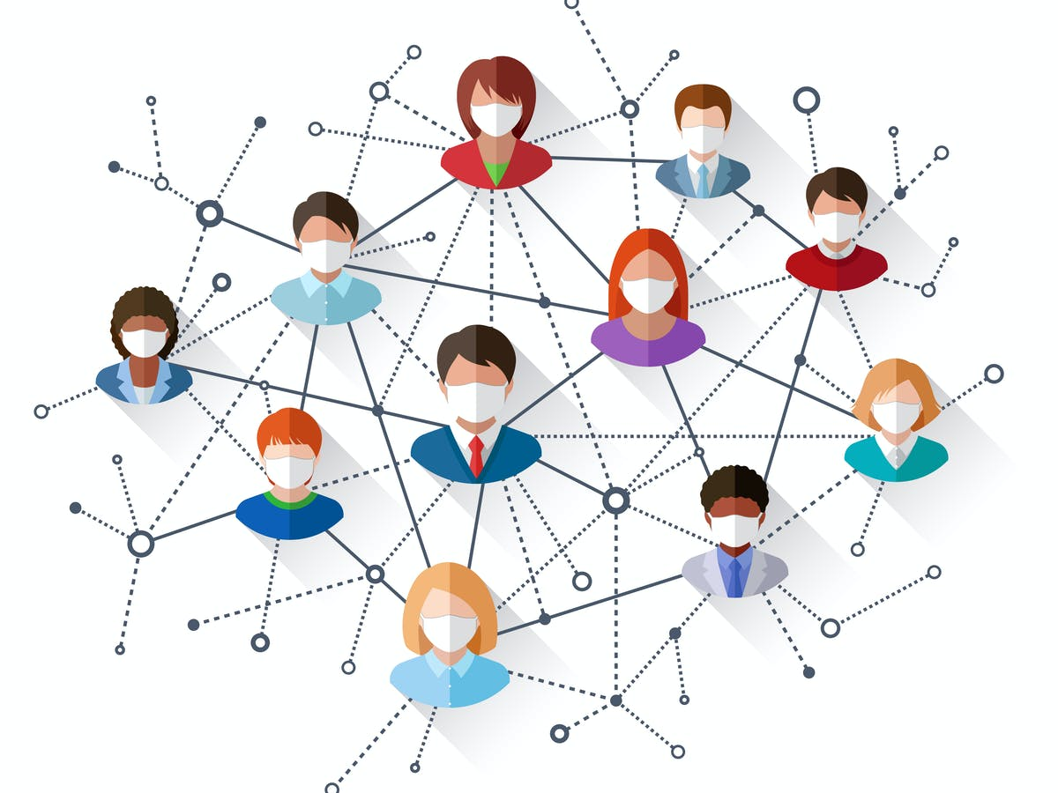
Introduction and Motivation
Contact Tracing has proved to be effective at reducing the spread highly transmissible viruses [1].
Existing methods of digital contact tracing are not effective at very closes ranges [2].
Any new system must utilize existing technologies to keep costs down. This requires power efficient design to promote usability and sustainability.
Contact tracing network [1].

Slide 4
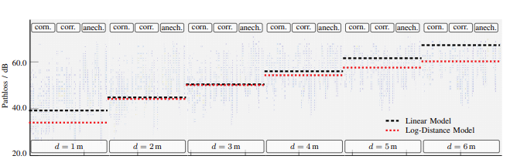
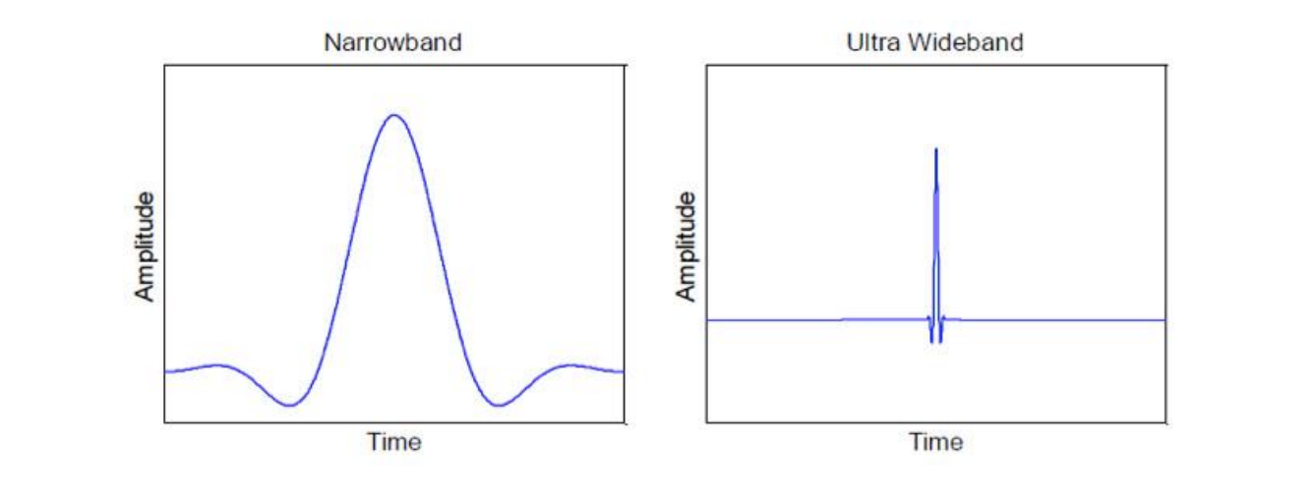
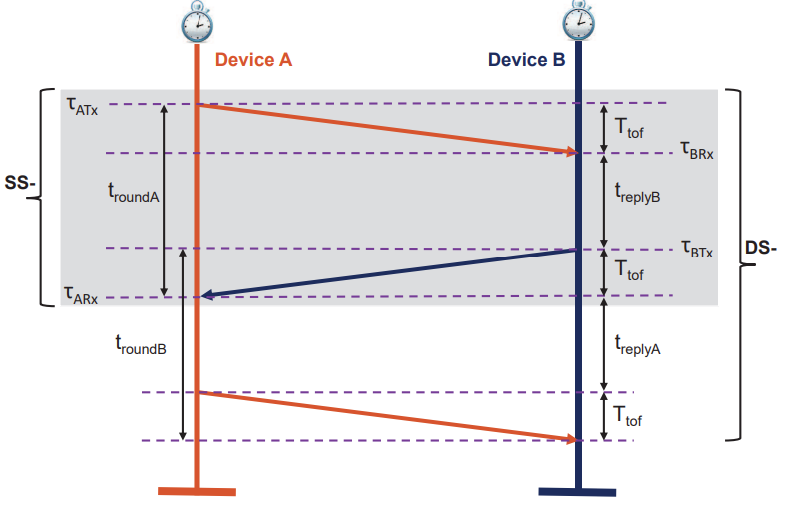
Heatmap of BLE pathloss [2].
Background
Distance Sensing
BLE used RSSI method of estimating distance using a path-loss model.
This method is highly dependent on the environment and relative orientation of antennas [3].
UWB uses Time of Arrival (ToA) method which is more accurate [4].
Narrowband vs. Wideband pulse [3].
SS-TWR and DS-TWR Iteration [4].

Slide 5
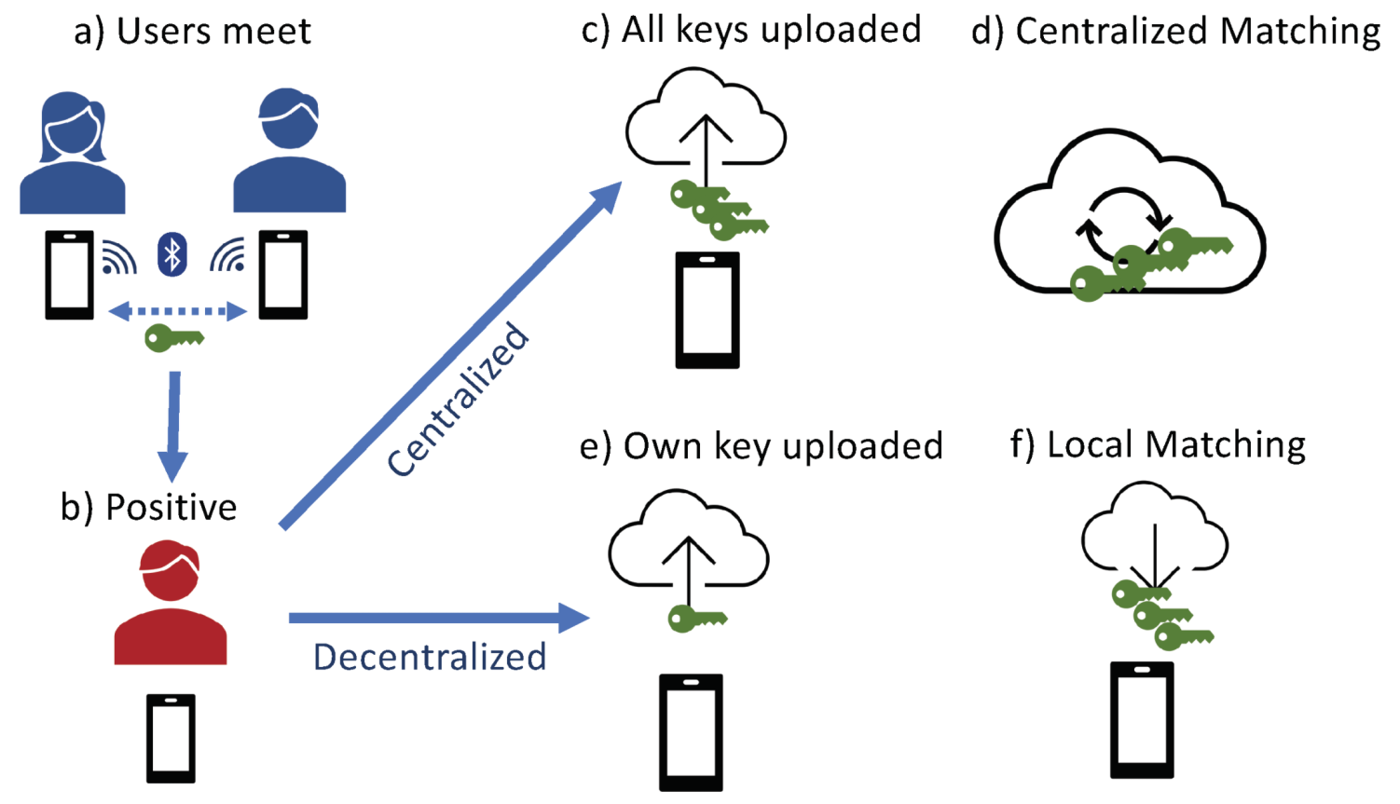
Background
Contact Tracing
Centralised and Decentralised approaches to digital contact tracing.
Compromise between effectiveness and data privacy.
Centralised vs. Decentralised contact tracing approaches [5].

Slide 6
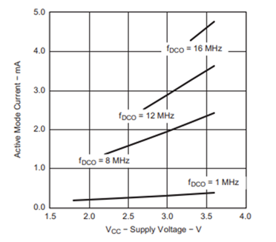
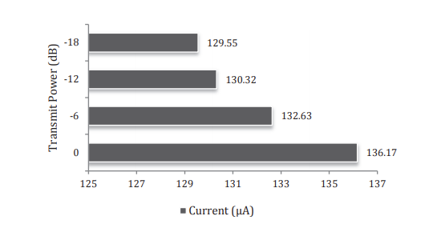
Background
Power Efficient Design
MSP430 - Active Mode vs Vcc, Ta = 25C [6].
Main areas of power dissipation in an embedded system are: (1) Computational Units, (2) Communication Units, (3) Storage Units.
Contact tracing systems expend most power on communication.
Power efficiency must be incorporated during the design phase and not an afterthought.
Transmit power and current consumption [7].

Slide 7

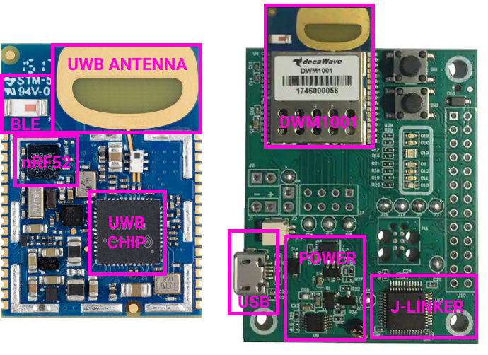
Component Selection
DWM1001
Zephyr RTOS

Slide 8
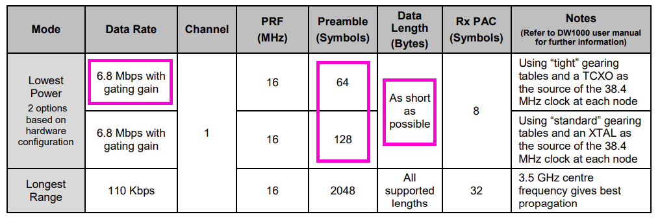
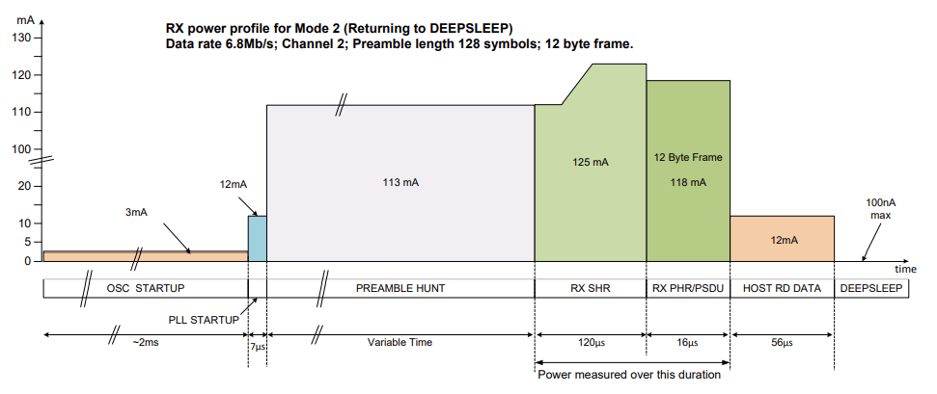
Power Optimisation Techniques
Ultrawide Band Modes
DW1000 lowest power and longest range modes operation [8].
UWB chip has many operating modes each with their distinct advantages and disadvantages.
The lowest power mode provided adequate range for the purposes of contact tracing.
SS-TWR provided comparable accuracy to DS-TWR with 66% the energy consumption.
Receiver sequence [8].

Slide 9
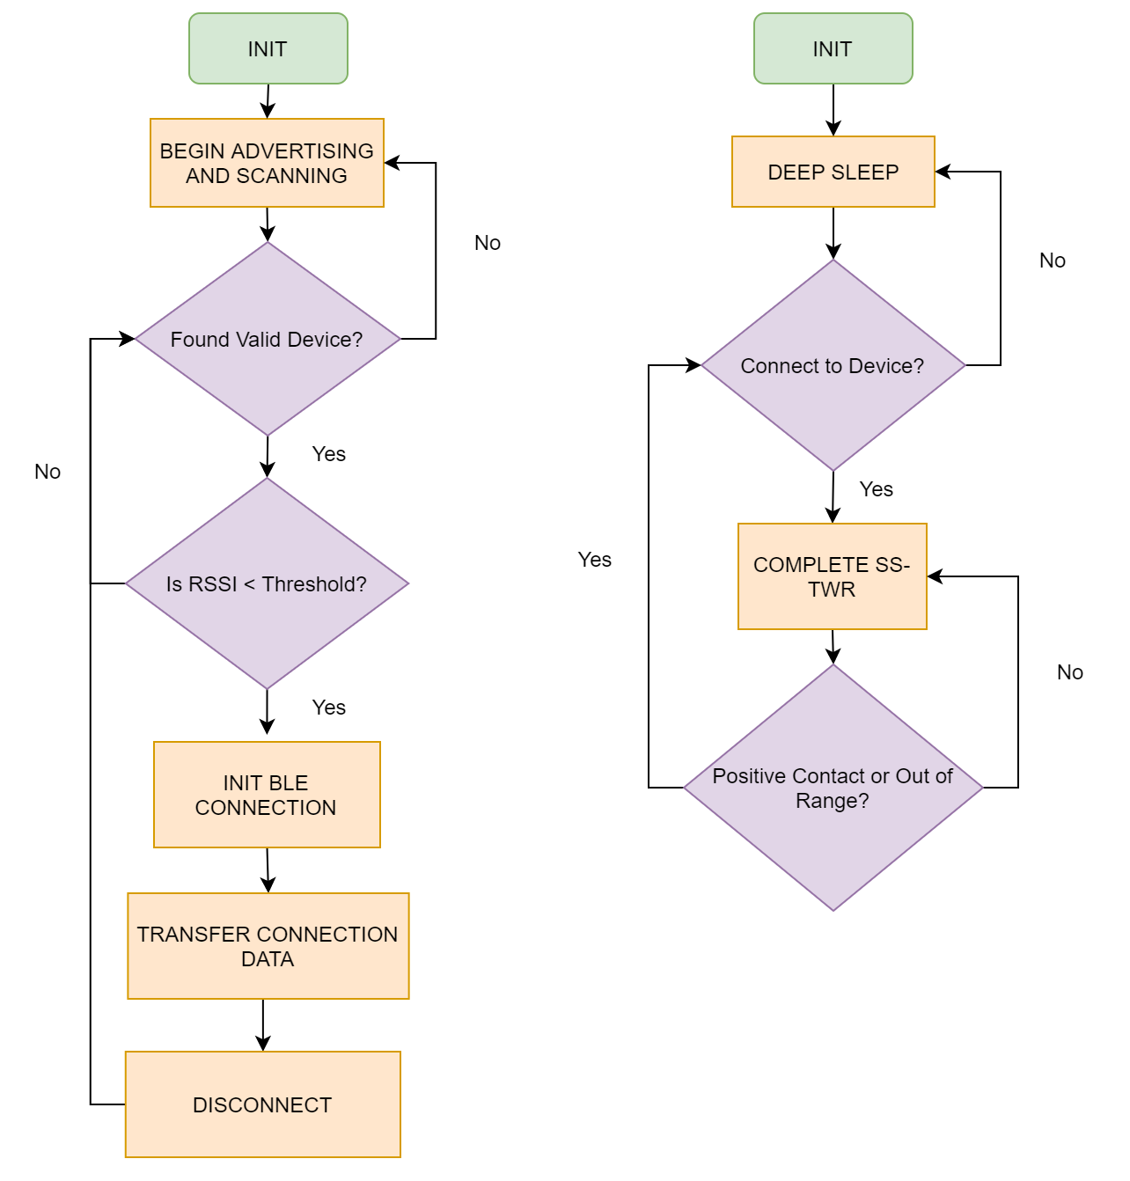
BLE Thread
UWB Thread
Power Optimisation Techniques
Combining UWB and BLE
UWB Receiver consumes excessing power because it is amplifying a wide frequency range.
Using BLE for device identification and distance sensing initiation reduces UWB receiver on time.
Result combines the low scanning power of BLE with the high precision of UWB.

Slide 10
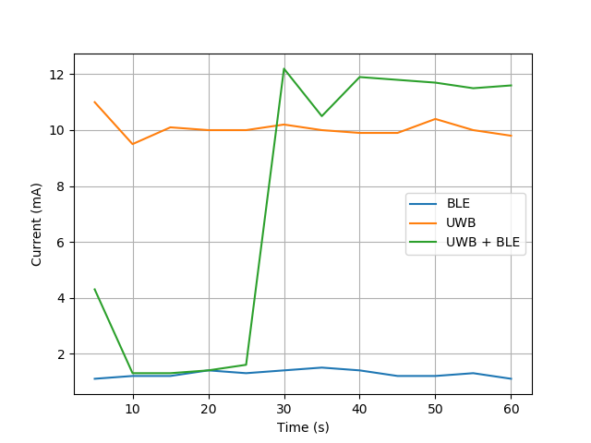
Power Optimisation Techniques
Combining UWB and BLE
UWB Receiver consumes excessing power because it is amplifying a wide frequency range.
Using BLE for device identification and distance sensing initiation reduces UWB receiver on time.
Result combines the low scanning power of BLE with the high precision of UWB.
Current consumption of combined operation.

Slide 11
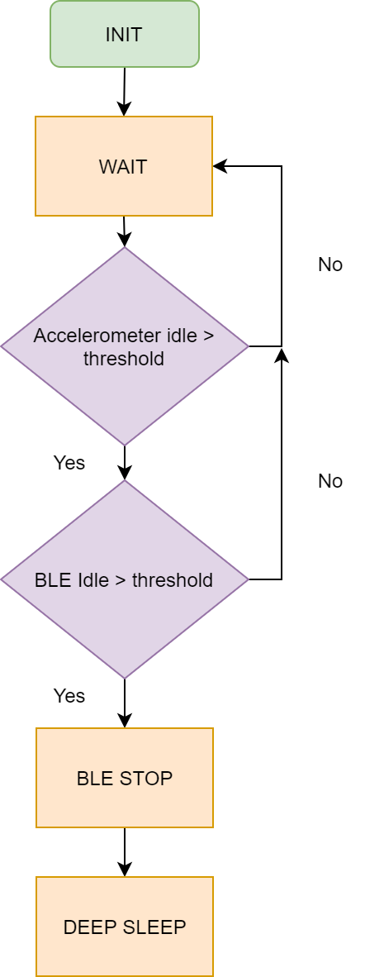
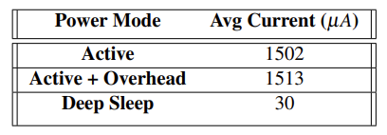
Power Optimisation Techniques
Deep Sleep
System is idle for much of its operating time.
This can be due to the user being isolated or not wearing the device.
Switching off power consuming BLE and UWB threads can extend battery life dramatically.
Overhead associated with monitoring the activity state must be less expensive than the power savings.
Power savings of deep sleep mode along with overhead costs.
Deep sleep mode initiation procedure.

Slide 12
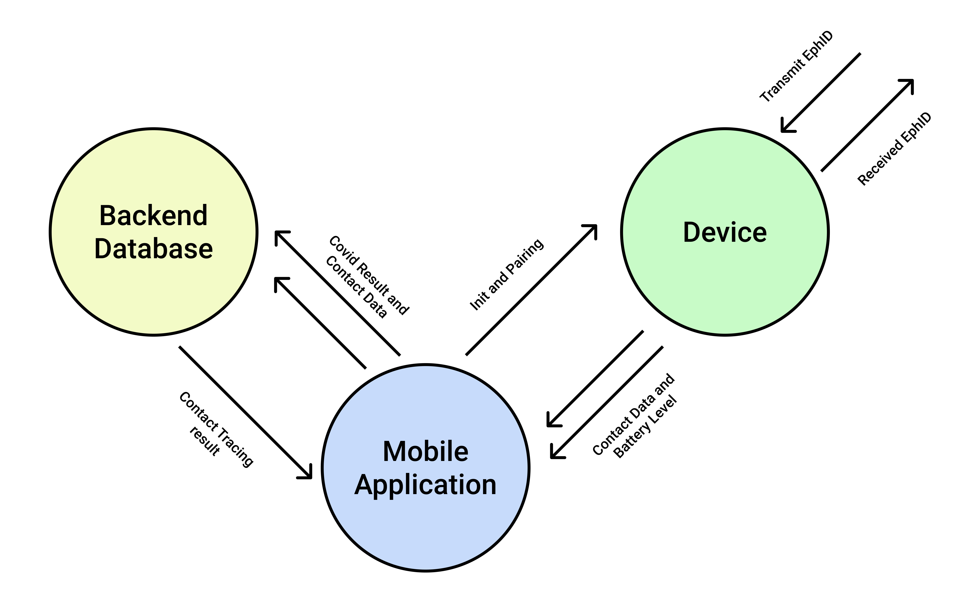
Prototype Development
System Overview

Slide 13
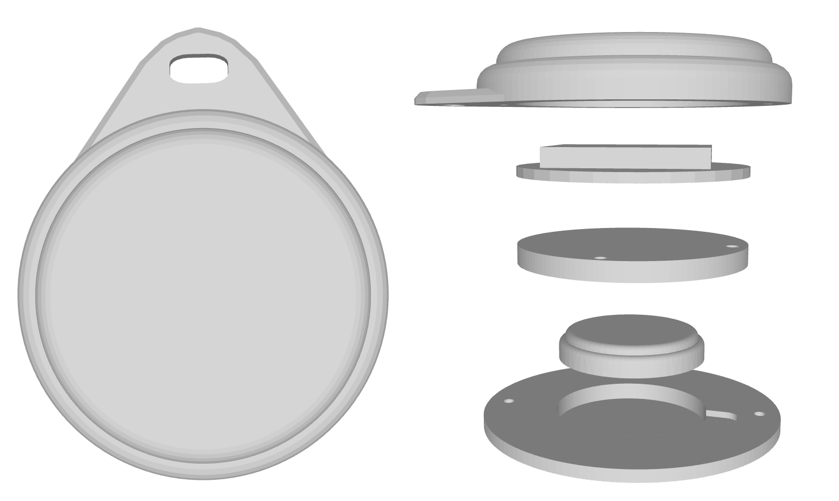
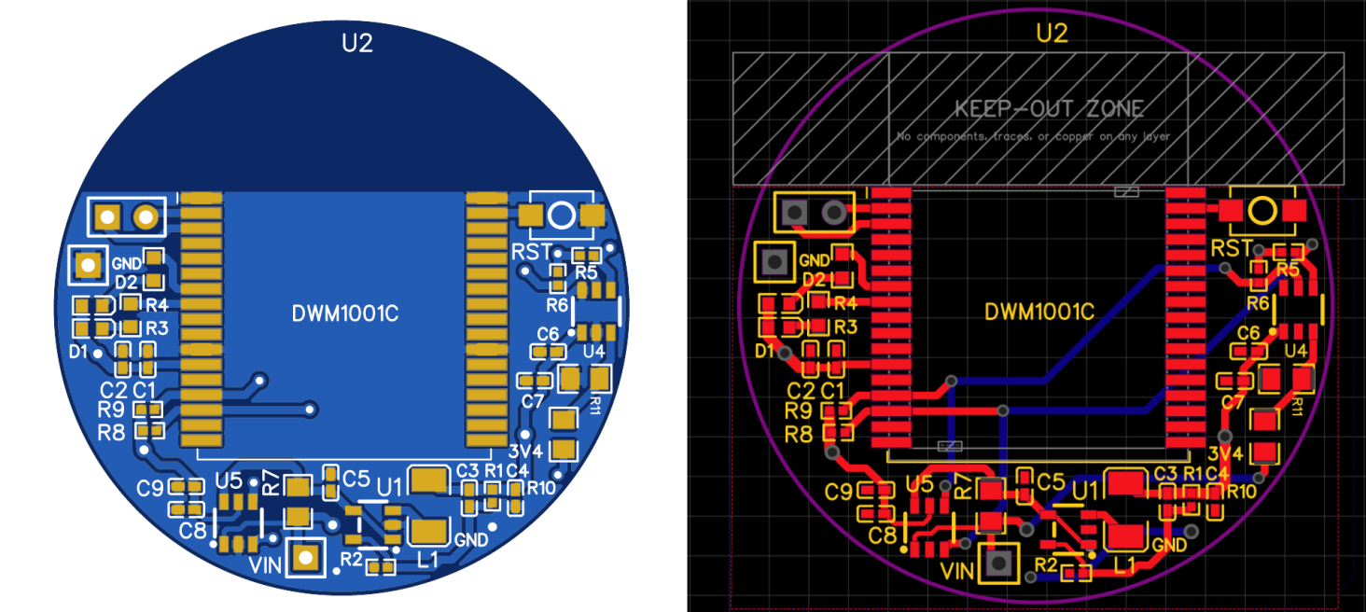
Prototype Development
Device Design
PCB Design
Casing Design

Slide 14
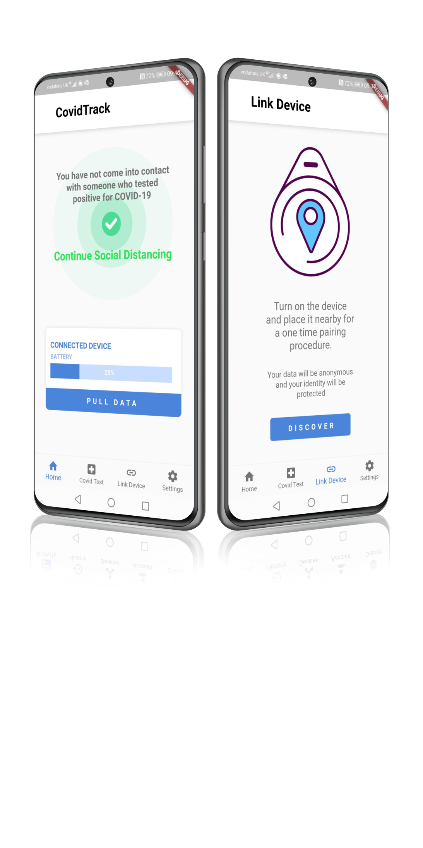



Prototype Development
Application
Role of application is to transfer data from device to backend and inform user of positive contacts.
Provides additional information about the device status.
Flutter
Firebase
Multiplatform
Easy to create UI with robust features
Scalability database along with user authentication services
Single codebase compiles to multiple operating systems

Slide 15
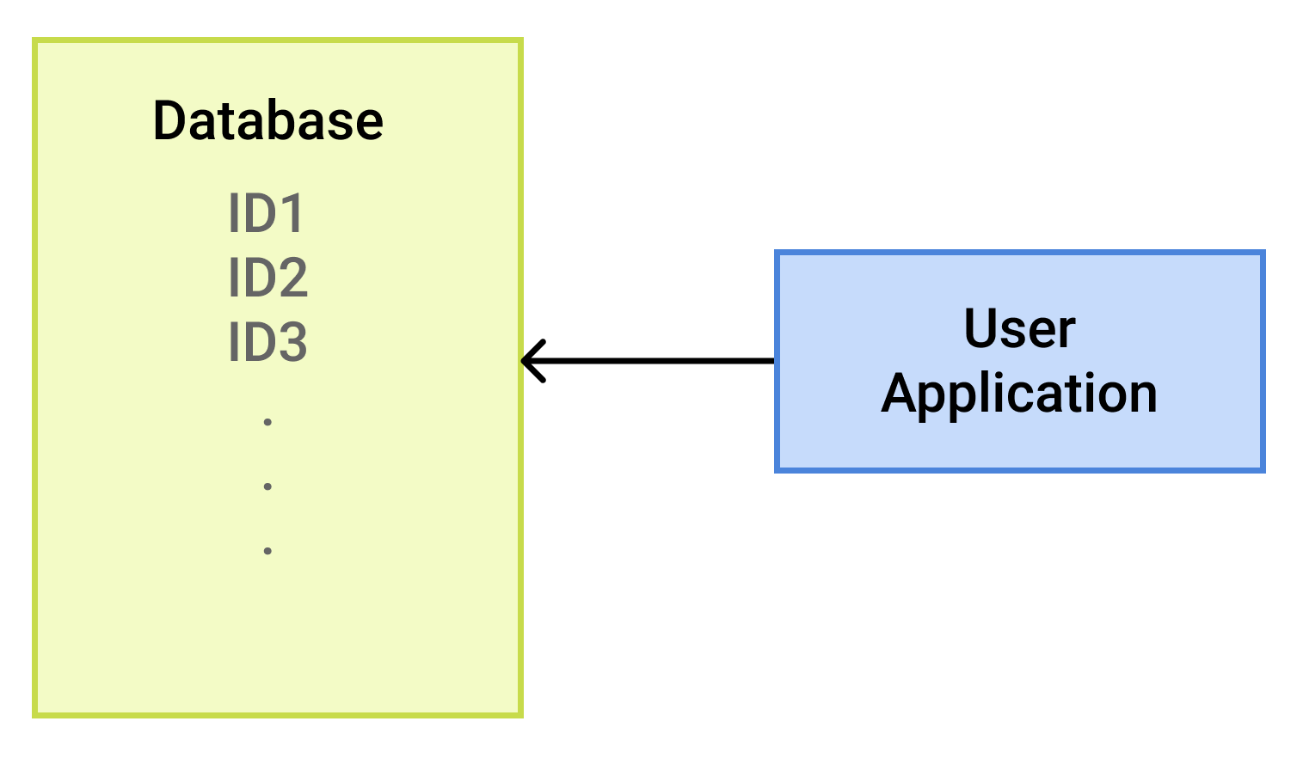
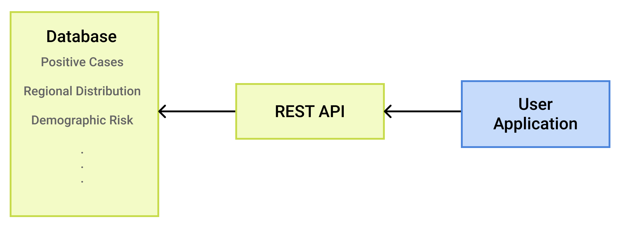
Prototype Development
Contact Tracing Algorithm
Decentralised Approach
Centralised Approach

Slide 16
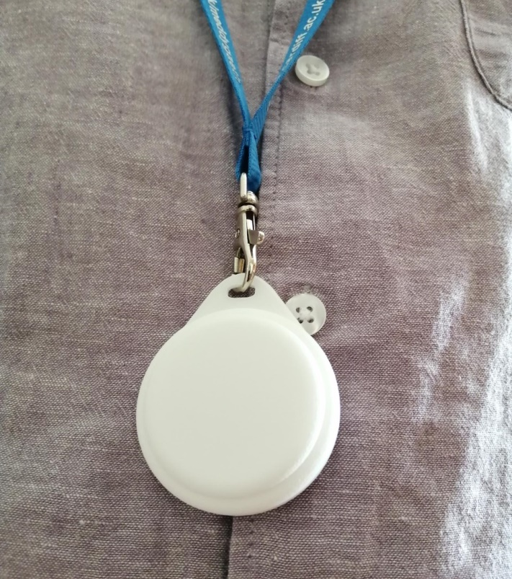

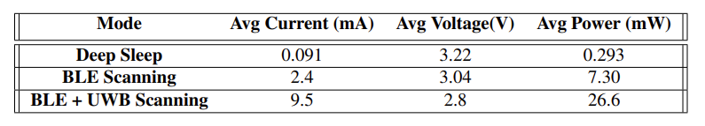
Final Results
System Performance Comparison
Power Efficiency Results

Slide 17
Conclusion and Further Development
Overall, was successful at constructing a working system which met most of the design requirements of a contact tracing wearable.
Was not able to implement all the functionality.
Power efficiency is not adequate for a releasable product; further optimisations are necessary.
Further development could include:
Lower level integration between UWB and BLE drivers
Improvement in contact tracing algorithm requiring fewer readings
Further exploration of centralised contact tracing algorithms.

Slide 18
References
[1] This DIY contact tracing app helps people exposed to COVID-19 remember who they met, https://theconversation.com/this-diy-contact-tracing-app-helps-people-exposed-to-covid-19-remember-who-they-met-151168 [Accessed 18/06/2021]
[2] H. Cho, J. Ji, et al., “Measuring a distance between Things with improved accuracy”, ScienceDirect, doi: 10.1016/j.procs.2015.05.119, Jun 2015
[3] L. Darmon, “Wireless for wearables”, https://www.decawave.com/wireless-forwearablesembedded-computer-design-us/, [Accessed: 15/01/2021].
[4] C. Sang, M. Adams, et al., “Numerical and Experimental Evaluation of Error Estimation for Two-Way Ranging Methods”, Sensors, Online Article, Feb 2019.
[5] E. Hernandex-Orallo, C. Calafate, et al, “Evaluating the Effectivness of COVID-19 Bluetooth-Based Smartphone Contact Tracing Applications”, Applied Sciences, Open Access Article, https://doi.org/10.3390/app10207113, Oct 2020.
[6] MSP430, Texas Instruments, 2013.

Slide 19
References Cont.
[7] H. Kalantarian, N. Alshurafa, et al., “Power Optimization for Wearable Devices”, 2015 IEEE International Conference on Pervasive Computing and Communication Workshops (PerCom Workshops), St. Louis, MO, 2015, pp. 568-573.
[8] DW1000, Decawave, v2.09, 2015.

